Slide 1


AES-P1 Specifications Presentation

Slide 2
1
Introduction

Slide 3
DG TAXUD
The Directorate-General for Taxation and Customs Union (DG TAXUD) is a Directorate-General of the EC.
DG TAXUD manages, defends and develops the customs union. It also co-ordinates taxation policy across the EU.
DG TAXUD publishes functional specifications (e.g. BPMN models) and technical specifications (e.g. Sequence diagrams) for the Member States National Authorities, in order for them to implement trans-European and national customs systems. DG TAXUD also participates in the publication of the EU customs legislation.

Slide 4
EU Customs Legislation (1)
UCC (02013R0952)
The Union Customs Code (UCC), issued by the European Parliament and the European Council, is the main legal framework for customs rules and procedures in the EU customs territory.
The Union Customs Code (UCC) requires the European Commission and the Member States to upgrade some existing electronic systems and introduce some new systems for the completion of customs formalities. In total, the UCC requires the upgrading or creation of fourteen trans-European systems and three national systems.
First issued in 2013.

Slide 5
EU Customs Legislation (2)
UCC IA (02015R2447)
Implementing Acts are legally binding acts that enable the Commission to set conditions that ensure that EU laws are applied uniformly (e.g. Codelist values).
First issued in 2015.
UCC DA (02015R2446)
Delegated Acts are legally binding acts that enable the Commission to supplement or amend non‑essential parts of EU legislative acts (e.g. Data Elements details).
First issued in 2015.

Slide 6
EC Artefacts Lifecycle
Legislation (defined previously)
Functional Specifications:
Translation of the business or legal requirements into functional or system requirements as a basis for the development of technical specifications for the related IT systems.
Development of process and data specifications.
Technical Specifications (defined as follows)
Each phase runs many iterations until its completion and once completed can lead to updates in previous phases as well.
Member States assist the Commission in the development of the legislation and the specifications, either by providing feedback or by participating in working groups, several times throughout the lifecycle of these artefacts.

Slide 7
2
Design Document for National Applications (DDNA)

Slide 8
DDNA Structure
The DDNA consists of the following six volumes:
Design Document for National Transit Application volume (DDNTA) for NCTS-P4;
Design Document for National Export Application volume (DDNXA) for ECS-P2;
Design Document for National Import Application volume (DDNIA) for ICS-P1;
Design Document for National Transit Application volume (DDNTA) for NCTS-P5;
Design Document for National Export Application volume (DDNXA) for AES;
Design Document for Common Operations and Methods volume (DDCOM).
AS-IS Functionality
TO-BE Functionality

Slide 9
DDNxA Structure
I General Introduction
Purpose; Scope; Structure; Acronyms and Abbreviations; Reference documents; DDNxA Appendices.
II Scope of development
A map of all the Information Exchanges between the system and other systems or physical users.
III [x]
The TO-BE system functionality consisting of Actors, Scenarios Descriptions, Time Sequence Diagrams, State Transition Diagrams and Timers Descriptions.
IV [x] Transitional Scenarios
This section contains a roadmap on how to transcend from the Legacy system to To-Be system and the specific functionalities to be supported during the transition period.

Slide 10
DDNxA Appendices (1)
#Ref | Name | Format | Description
A | Message Scope | MS Excel | This appendix defines the scope of Information Exchanges for AES-P1. The IE Scope worksheet illustrates the IEs that are within the scope of AES-P1. In addition, it includes the messages of ECS-P2 so as to depict predecessors IEs in previous phase.
B | Transitional Analysis | MS Word | The purpose of this Appendix is to provide the approach followed for the transitional analysis from ECS-P2 to AES-P1.
C | Code List Definition | PDF/ MS Excel/ XML | This appendix provides the Code Lists definition.
D | History of Rules & Conditions | MS Excel | This appendix provides the history of Rules & Conditions.
J | Correlation Tables of Data Items and Data Groups | PDF | The Appendix J Correlation Tables contains an overview of the Data Groups and Data Items used across the Information Exchanges for AES-P1.
K | Rules and Conditions Mapping | PDF/ MS Excel | This appendix presents the mapping of Rules and Conditions in Data Groups and Data Elements as presented in Appendix Q2.
M | Scenario Transition Analysis output | MS Excel | ECS-P2 to AES-P1 Scenario Transition Analysis output.

Slide 11
DDNxA Appendices (2)
#Ref | Name | Format | Description
N | State Machine Transition Analysis output | MS Excel | This appendix presents comparison of State Machines between AES-P1 and ECS-P2. The comparison is performed per Customs Office and per procedure.
Q2 | Technical Message Structure | PDF | This appendix describes the Technical Message Structure (TMS) of DDNXA for AES-P1 as a technical implementation of each Functional Message Structure (FMS).
Q2 R_C | Rules & Conditions | MS Excel | This appendix presents the technical description of Rules and Conditions incuded in Appendix Q2.
R | XML Mapping of Data Items and Data Groups | PDF | This document presents the mapping of Data Groups and Data Elements between Appendix Q2 names and the XSD XML tags.
S | Recommended Transitional Measures on ED and ND messages | MS Excel | Appendix S defines the recommended transitional measures on External Domain and National Domain messages, based on the extracted comparison with the baseline messages.
X | XML Schemas of Messages | XSD | XML Schemas of Messages
Y | Data groups and Transaction hierarchy | PDF | This document presents the overall Data Group structure of the messages supported for AES P1. The Data Groups are shown in a hierarchical format as presented in Appendix Q2.

Slide 12
XML Schema Definitions (XSDs)
#Ref | Name
ctypes.xsd | Contains the XML complex type elements.
htypes.xsd | Contains the Header (MESSAGE) data group elements: Message sender; Message recipient; Preparation date and time; Message identification; Message type. Correlation identifier.
doc.xsd | Contains the documentation elements: description; rule; condition; codeList.
stypes.xsd | Contains the XML simple type elements.
tcl.xsd | Contains Code List values for the following Code Lists: CL024 - Modification Type; CL026 - Month of Year; CL027 – Flag; CL030 - XML Error Codes; CL060 - Message Types; CL070 - Country Codes (Customs Office Lists); CL079 - System Unavailability Type; CL180 - AES/NCTS P5 Functional Error Codes.

Slide 13
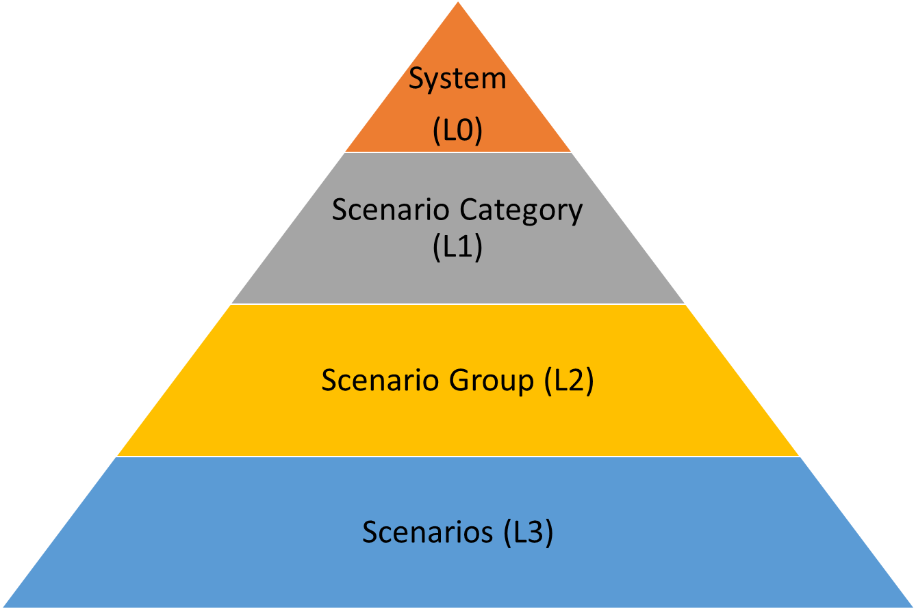
DDNxA Hierarchical Organisation of Scenarios (levelling) (1)
The root system functionality (e.g. AES)
The high-level scenario categories (e.g. Exit Summary Declaration)
A sub-grouping of scenarios based on the covered business (e.g. Centralised Clearance)
The detailed scenarios belonging to a scenario group (e.g. Rejection of declaration)

Slide 14
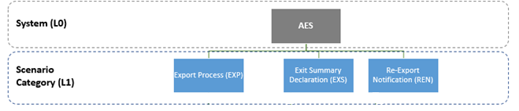
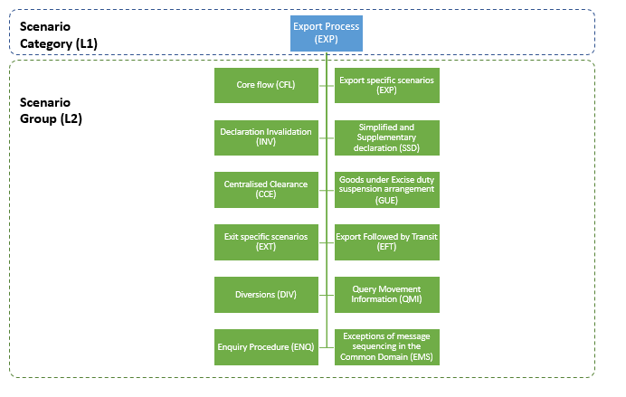
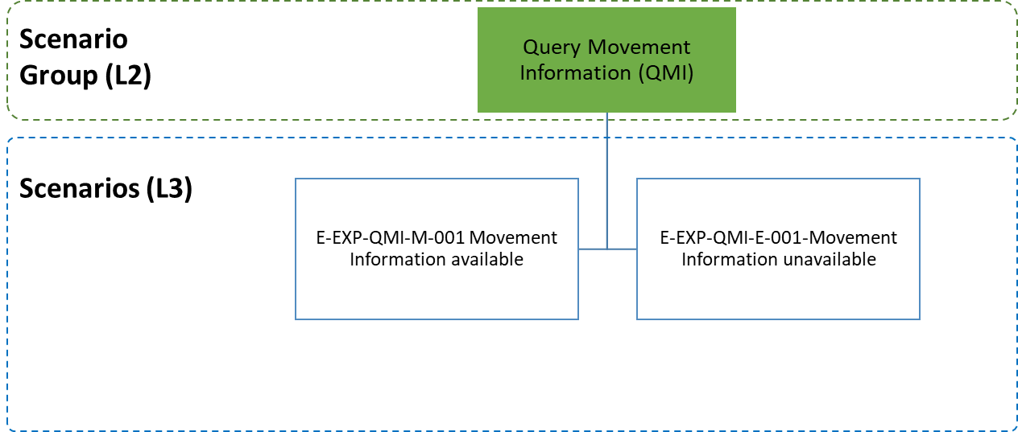
DDNxA Hierarchical Organisation of Scenarios (levelling) (2)
L0
L1
L2
L3

Slide 15
DDNxA Scenarios Classification
L0
L1
L2
Scenario ID: <System>-<Scenario Category>-<Scenario Group>-<Scenario Type>-<Scenario Number>
Scenario Type:
M for Main/Core Flow
A for Alternative Flow
E for Exception Flow (rejections)
Example: E-EXP-CFL-M-001 Core flow
Sequential number per group of scenarios (e.g. 001)
Scenario Name

Slide 16
DDNxA Time Sequence Diagrams (TSDs)
Role
Customs Authorities role shown with turquoise colour
Economic Operator role shown with bright green colour
Self-message
Lifeline
Message
Common Domain Information Exchange shown with blue colour
National Domain Information Exchange shown with purple colour
Object
External Domain Information Exchange shown with green colour
Note
Timer event

Slide 17
DDNxA Scenarios Description (1)
Each scenario description is separated in sequential steps which correspond to functionality between messages or self-messages of the related TSD.
Every time an IE is mentioned in a description, then the IE Name, Reference and Number is included.

Slide 18
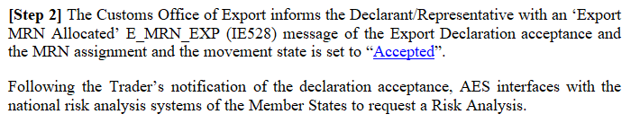

DDNxA Scenarios Description (2)
States transitions are mentioned in the descriptions with a cross-reference to the corresponding State Transition Diagram.
Timer events (start, stop, expire, reset) are mentioned in the descriptions with a cross-reference to the corresponding Timer Description.

Slide 19
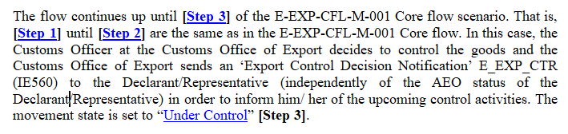
DDNxA Scenarios Description (3)
Whenever a part of another scenarios’ functionality is repeated in the current scenario, then the corresponding steps are mentioned with a cross-reference.
The total number of steps from another scenario will be included in the steps numbering.
In this case the description starts from step 3.

Slide 20
State Transition Diagrams (STDs) (1)
Final State
Start State “None”
State Transition Patterns
Intermediate State
Trigger - Event
Result – Sent IE
A[C]^B
A^B
[C]^B
A[C]
Where
A: Trigger (Received IE, decision, timer event)
C: Condition to be satisfied
B: Result (Sent IE)
Trigger – Received IE
Condition
Note

Slide 21
State Transition Diagrams (STDs) (2)
STDs should be studied along side Scenarios and Functional Timers for the complete understanding of the state transitions inside the procedures flow.
Each STD is designed for a specific flow object and a specific Customs Office.
Each state might appear in multiple scenarios.
Some states might share the same naming throughout STDs but they are not the same, except if they target the same flow object and the same Customs Office.

Slide 22
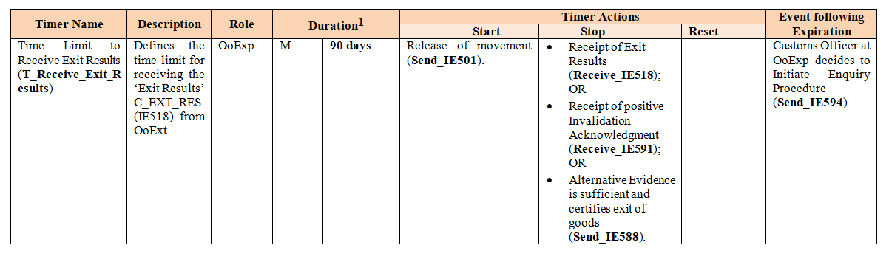
Functional Timers
Functional Timers should be studied along side STDs and TSDs for the complete understanding of their placement in the procedures flow.
The Customs Office handling the timer
The duration is counted in days
This can be one or more of the following: condition met, manual action, information exchange.
This can be a manual action, an information exchange or no action.
Mandatory or recommended

Slide 23
Information Exchanges (IEs) (1)
Currently most communications between systems and users in EU Customs context is performed electronically. UCC adoption and implementation aims at a paperless and fully automated customs union.
Under UCC, all IEs need to be formatted in XML format and transmitted across CCN/CSI.
Each TMS consists of the Message Description (an overview of the IE with collapsed Data Groups) and the Description of the different Data Items (an expanded view of the IE with the sequence of Data Items of each Data Group).
On DDNA level, each IE has a schema called Technical Message Structure (TMS).

Slide 24
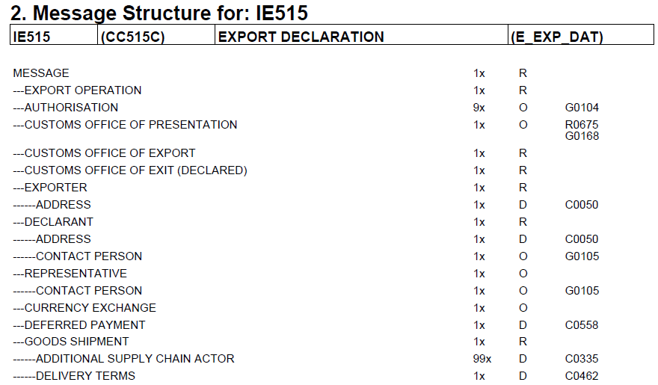
Information Exchanges (IEs) (2)
Message Description
“C_” denotes exchanges within the Common Domain between National or Central Customs Systems.
“E_” denotes exchanges in the External Domain between Customs Systems and Traders.
“N_” denotes exchanges within the National Domain between National Customs Systems and Non Customs National Systems.
IE Name
IE Reference
IE Number
IE Version
These DGs exist in all IEs, with different content in each IE.
This DG has technical content which concerns the exchange itself
Rule
Data group (DG): always written in capitals.
Condition
Multiplicity
Optionality

Slide 25
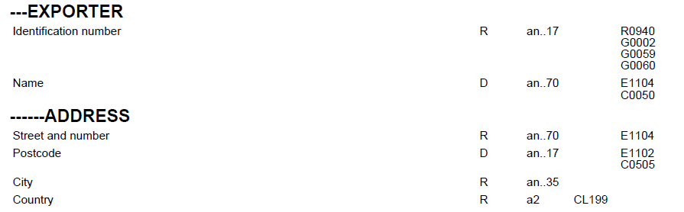
Information Exchanges (IEs) (3)
Description of the different Data Items
Optionality
Format
Rule
Condition
Data Item (DI): always written in sentence case.
Data group
Codelist

Slide 26
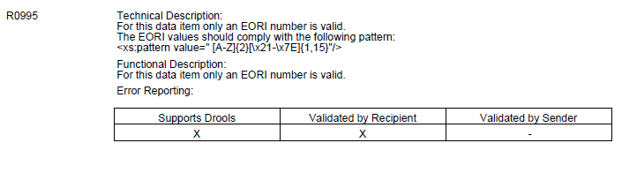
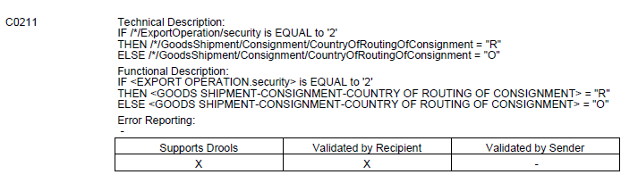
Information Exchanges (IEs) (4)
Rule
Specifies how a DG/DI can be used.
Condition
Specifies when a DG/DI can be used.

Slide 27
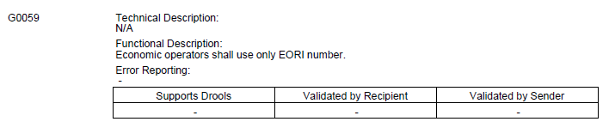
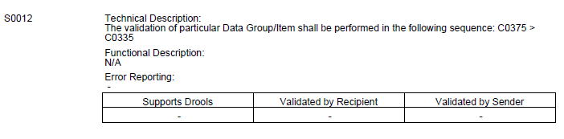
Information Exchanges (IEs) (5)
Guideline
Specifies how a DG/DI can be filled in.
Sequencing Rule
Defines in which order the Condition(s), Guideline(s), Sequencing Rule(s) and Rule(s) must be validated

Slide 28
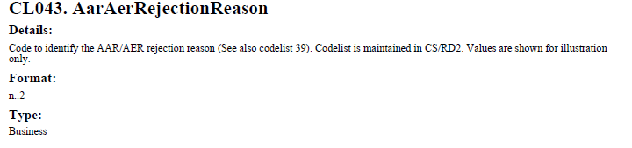
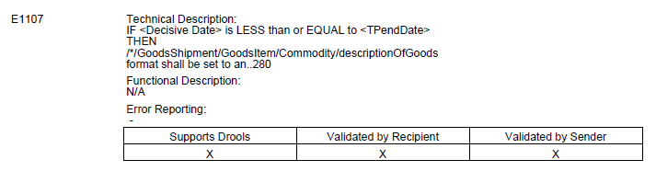
Information Exchanges (IEs) (6)
Codelist
The CL format must be compatible with the DI format.
If a CL is assigned to a DI then only the CL values can be selected as DI values.
Technical Rule for Transition
Specifies how to handle Data multiplicity and format after the Transitional Period

Slide 29
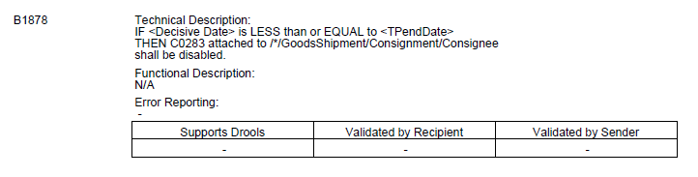
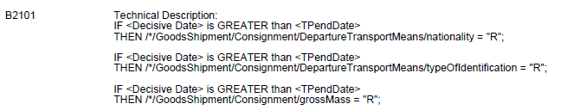
Information Exchanges (IEs) (7)
Business Rules for Transition – Category 1
Specifies how to handle R/Cs during the Transitional Period
Business Rules for Transition – Category 2
Specifies how to handle Data optionality after the Transitional Period

Slide 30
XSD

Slide 31
Thank you!

